Slide 1


K.RAMAKRISHNAN COLLEGE OF TECHNOLOGY
(AUTONOMOUS), TRICHY
Stock Market Trend Prediction Using MLT
PRESENTED BY
2303811724321066 - R MOHAMED ADHIL AMEEN
Notes:
1

Slide 2
PRESENTATION OVERVIEW
Problem Identification
Objective
Block diagram of proposed system
Data structures used
Advantages of proposed system
Module Description
Module Implementation
Source Code
Screenshot
Conclusion and Future Enhancement
Notes:
2

Slide 3
PROBLEM IDENTIFICATION
Inconsistent Data: Historical stock data can be incomplete or formatted inconsistently across platforms.
Sudden Market Shifts: Events like geopolitical crises or natural disasters can cause unexpected market fluctuations.
High-Frequency Trading Impact: Automated trading systems can create rapid, unpredictable market changes.
Lack of Real-Time Data: Delays in accessing real-time information can hinder timely decision-making.

Slide 4
OBJECTIVE
The objective of Stock Market Trend Analysis using Machine Learning Techniques (MLT) is to leverage advanced computational models to identify, predict, and understand market trends, enabling data-driven investment decisions.

Slide 5
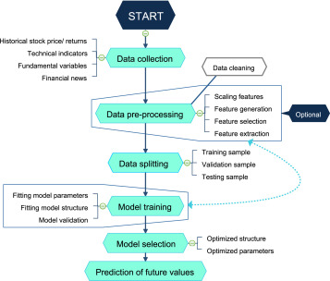
PROPOSED SYSTEM
BLOCK DIAGRAM

Slide 6
MACHINE LEARNING TECHNOLOGY USED
Linear Regression: Predicts stock prices based on historical trends.
Support Vector Regression (SVR): Handles non-linear relationships in stock data.
K-Means: Groups stocks with similar price behaviors.

Slide 7
ADVANTAGES OF PROPOSED SYSTEM
Sophisticated Models: Machine learning models, especially deep learning techniques like LSTM or transformers, can capture complex, non-linear relationships in financial data.
Time Savings: Automates the processing and analysis of large volumes of stock market data, significantly reducing manual effort.
Pattern Recognition: Detects hidden patterns and anomalies that may be invisible to traditional statistical methods.

Slide 8
MODULE DESCRIPTION
Data Collection and Preprocessing Module: This module collects raw data from various sources and prepares it for analysis.
Model Development and Training Module: This module develops and trains machine learning models for trend prediction.
Sentiment Analysis Module: Analyzes textual data from news and social media to gauge market sentiment.

Slide 9
MODULE DESCRIPTION
1. Data Collection and Preprocessing Module
Collect Stock Market Data: Use APIs like Alpha Vantage or Yahoo Finance to fetch historical and real-time stock data.
Preprocess Data: Handle missing values, normalize features, and create new features like moving averages.

Slide 10
MODULE DESCRIPTION
2. Model Development and Training Module
Split Data: Prepare training and testing datasets from historical stock prices.
Train a Machine Learning Model: Use an LSTM model for time-series prediction.

Slide 11
MODULE DESCRIPTION
3. Sentiment Analysis Module
Fetch Text Data: Scrape or use APIs to fetch news or social media posts.
Sentiment Analysis: Use pre-trained models like BERT for sentiment scoring.

Slide 12
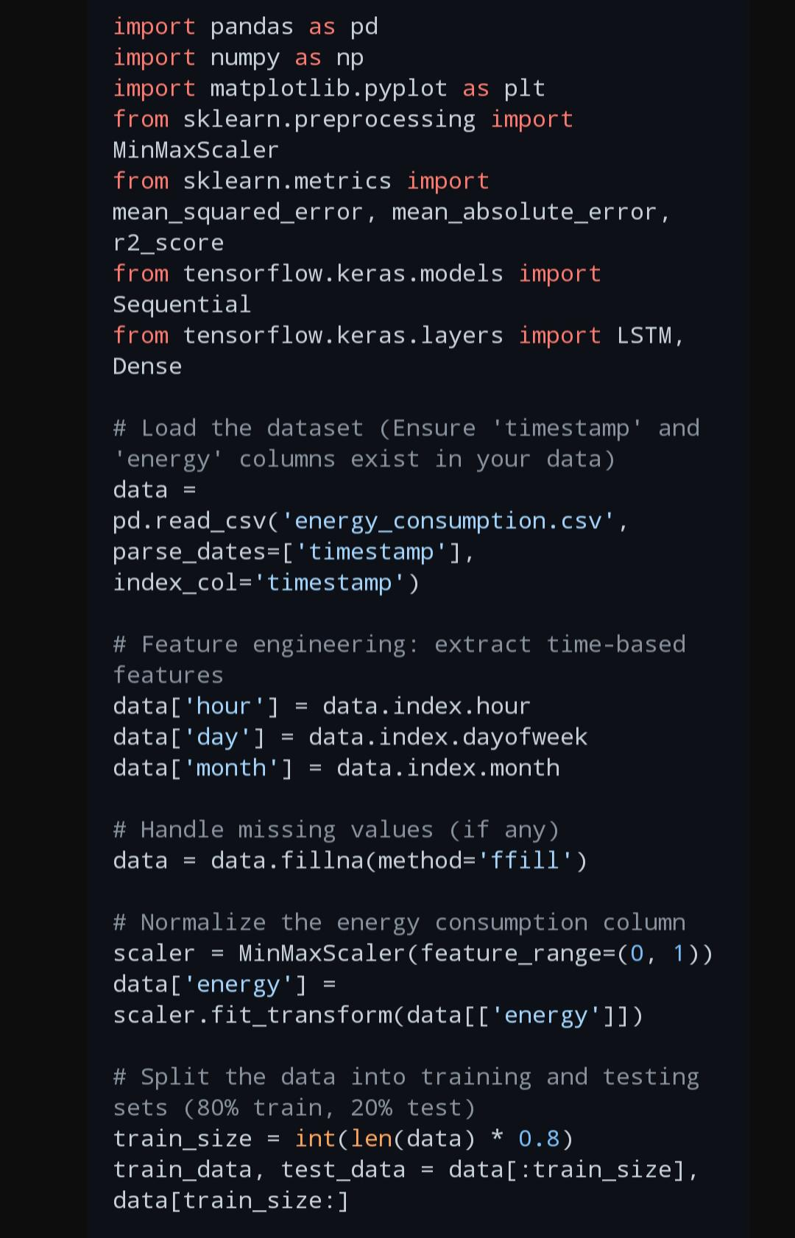
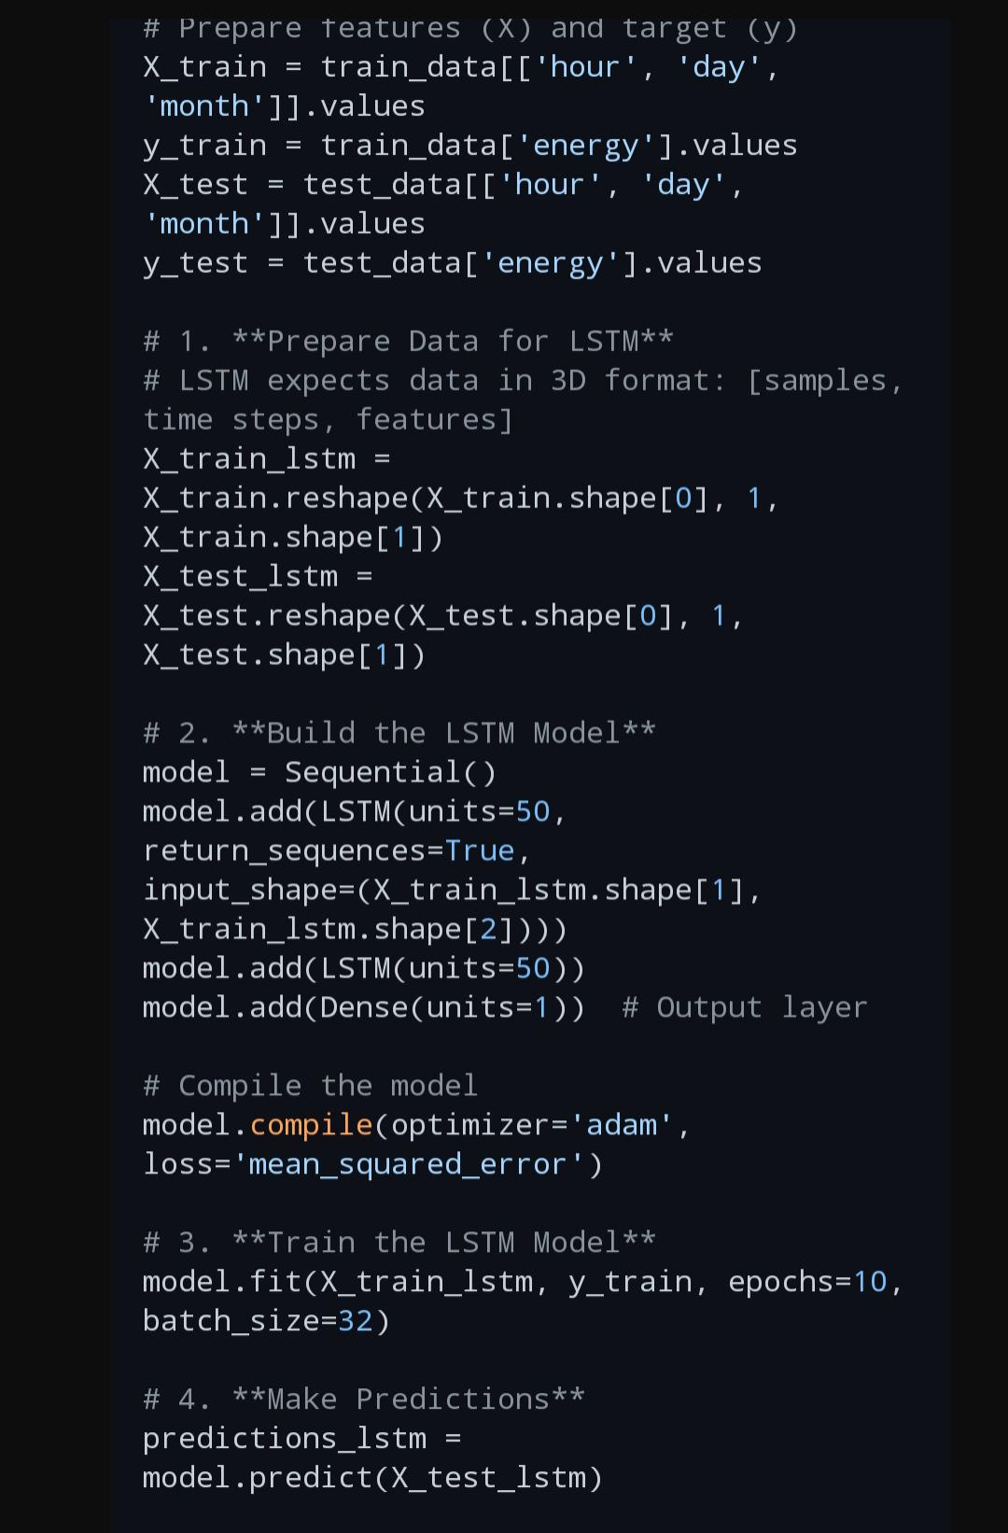
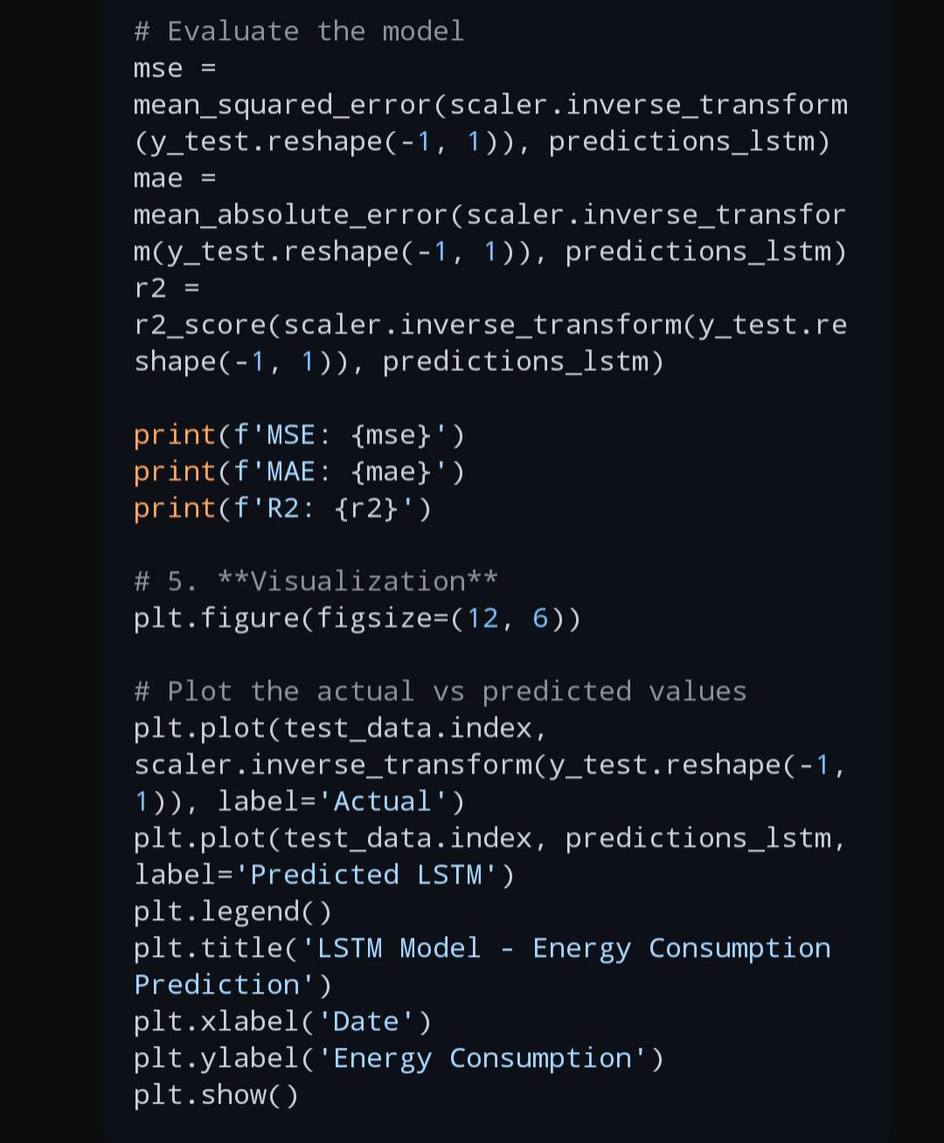
Source Code
Notes:
5

Slide 13
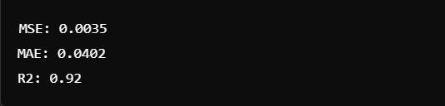
Screenshot
Notes:
6

Slide 14
CONCLUSION AND FUTURE ENHANCEMENT
The implementation of Stock Market Trend Analysis using Machine Learning Techniques (MLT) has demonstrated significant potential for enhancing market predictions and decision-making processes.

Slide 15
CONCLUSION AND FUTURE ENHANCEMENT
FUTURE ENHANCEMENTS:
Incorporate Alternative Data Sources
Global Market Data
Real-Time Predictive Analytics
Hybrid Models

Slide 16
THANK YOU
Notes:
8

